Slide 1
Viva Connections & SharePoint Framework Bi-weekly sync
aka.ms/m365pnp
Your host in this call: Vesa Juvonen
August 25th, 2022
Microsoft 365 PnP Team

Slide 2




Agenda
Latest update on the SharePoint Framework
Patterns and Practices Updates
PnPjs
CLI for Microsoft 365
Reusable PnP SPFx controls
New Community Samples
Picture time with Together Mode!
Demos
Tony Philips – Using the Microsoft Graph education endpoints in SPFx to create a my assignments web part
Waldek Mastykarz – Getting started on building custom list form experiences with SharePoint Framework

Slide 3
Opportunities to Participate in PnP SPFx / JS SIG
SPFx Demo
@pnp Demo
Contribute on GitHub
Provide Feedback
Web Part
Application Customizer
Provisioning
Anything you create!
PnPjs
CLI for Microsoft 365
SPFx Reusable Controls
SPFx Community Yeoman
Report Issues
Submit Pull Requests
Help with issues/questions
How are the calls?
Documentation needs?
Where can we help?
Positive is OK too!
Great opportunity to get visibility for you or your company. Demo sample or explain how you extend or customize SharePoint Online with live demo in your projects. Reach out to team for volunteering.
Request a demo spot on the call
https://aka.ms/m365pnp/request/demo

Slide 4
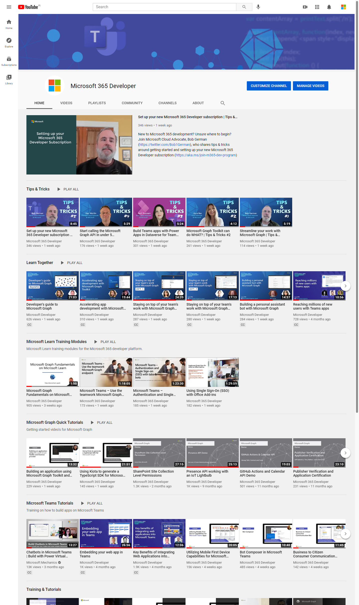
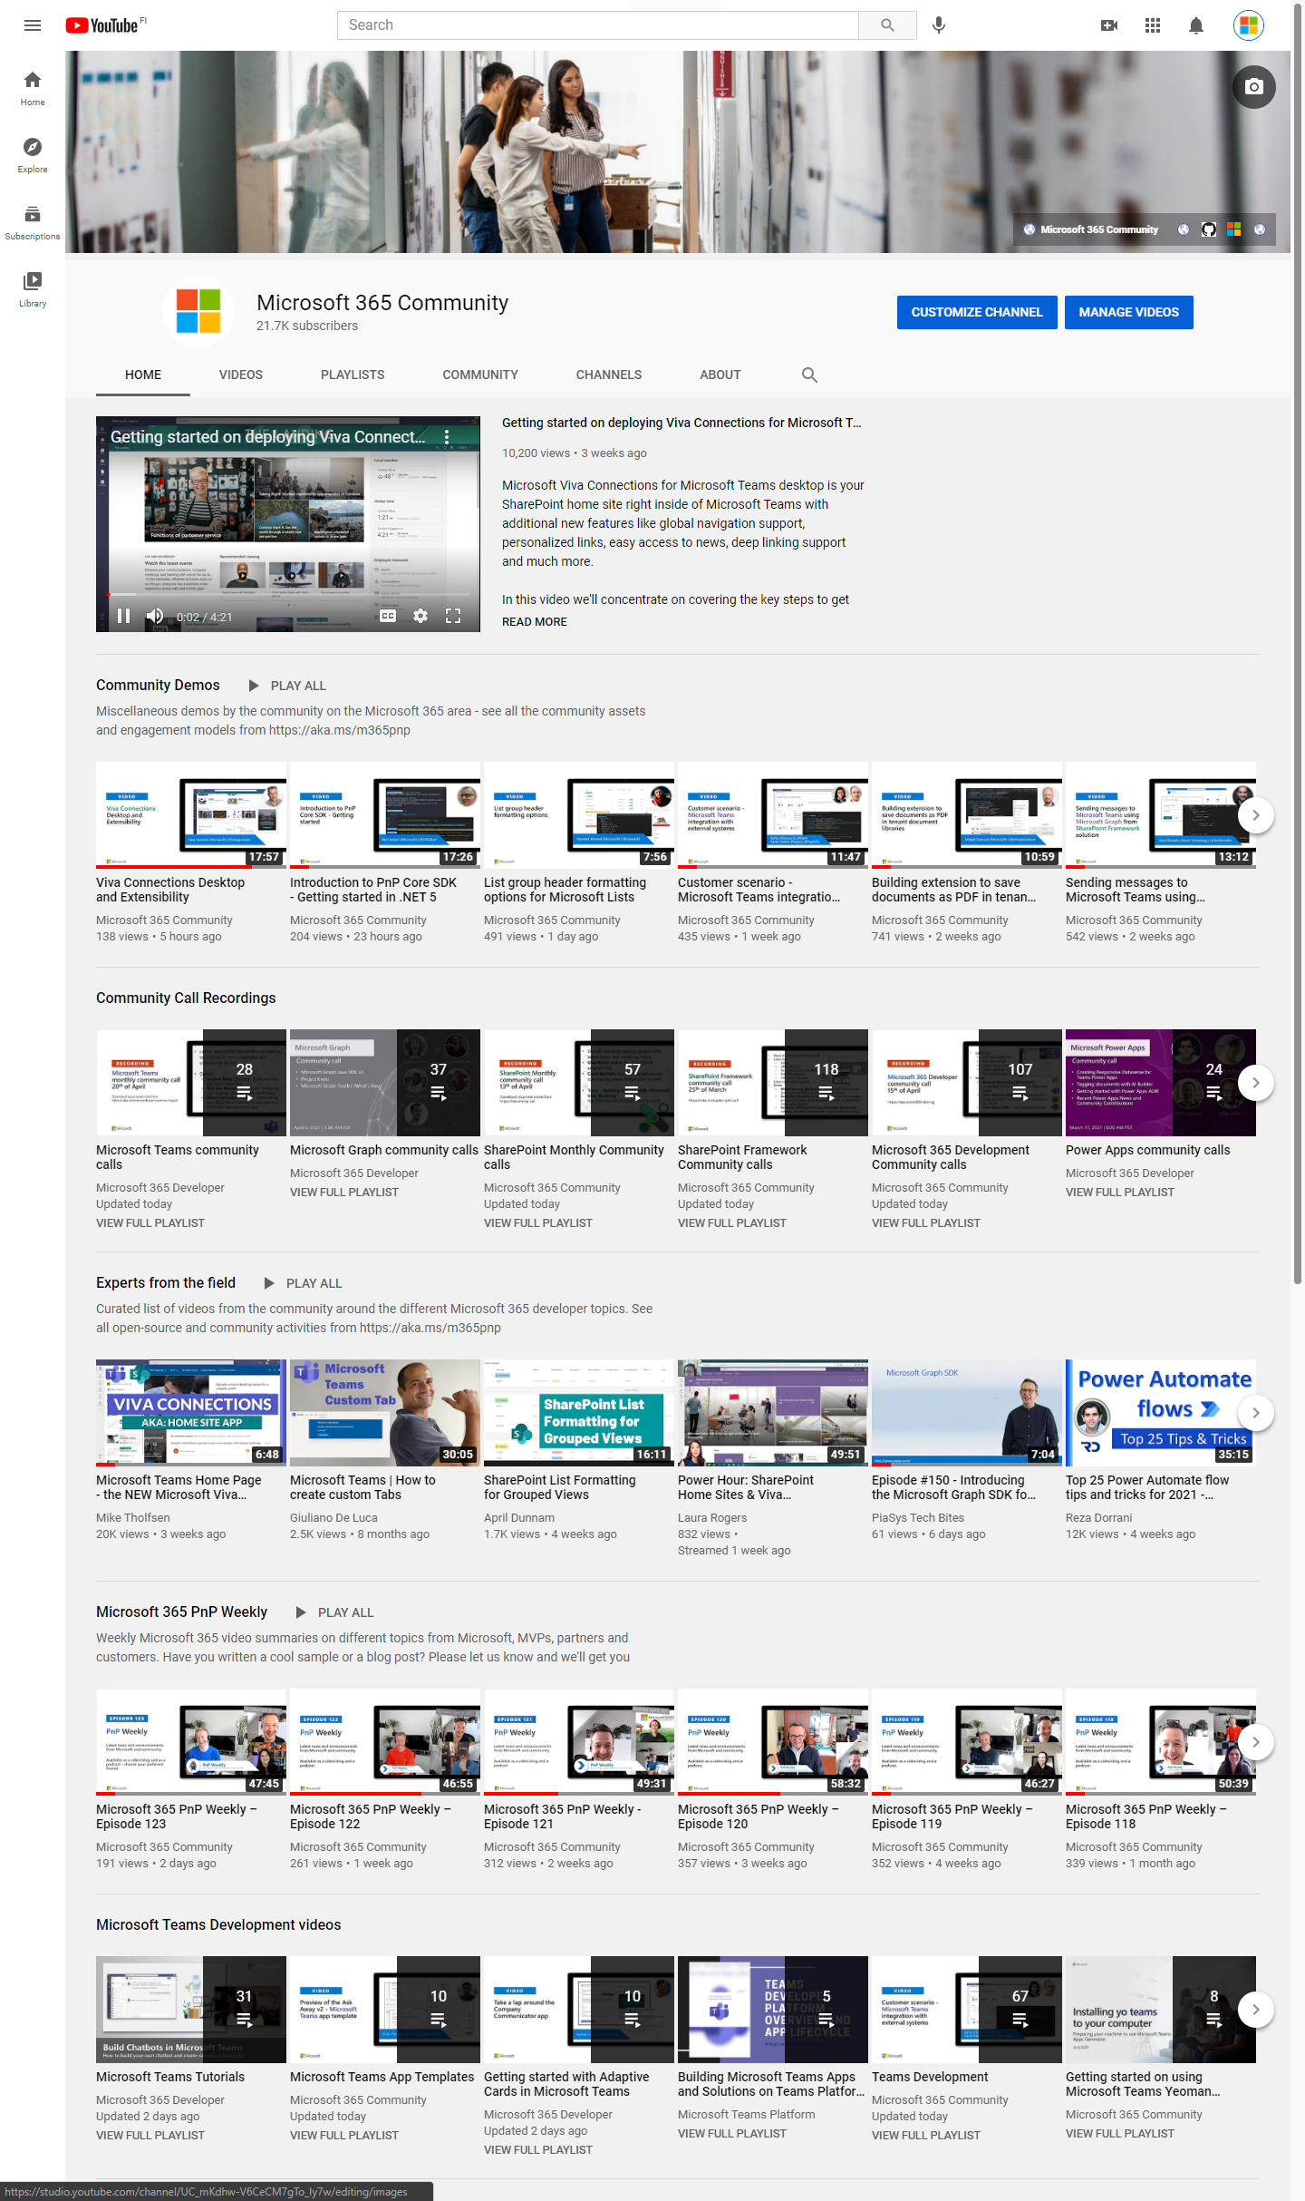
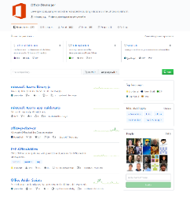
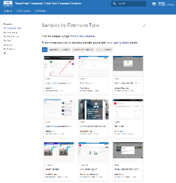
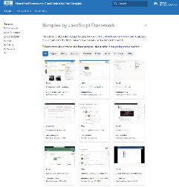
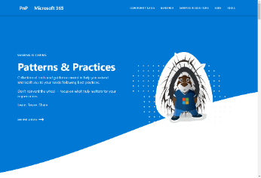
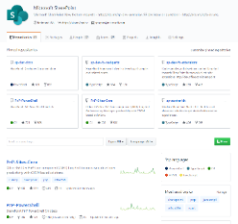
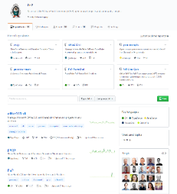
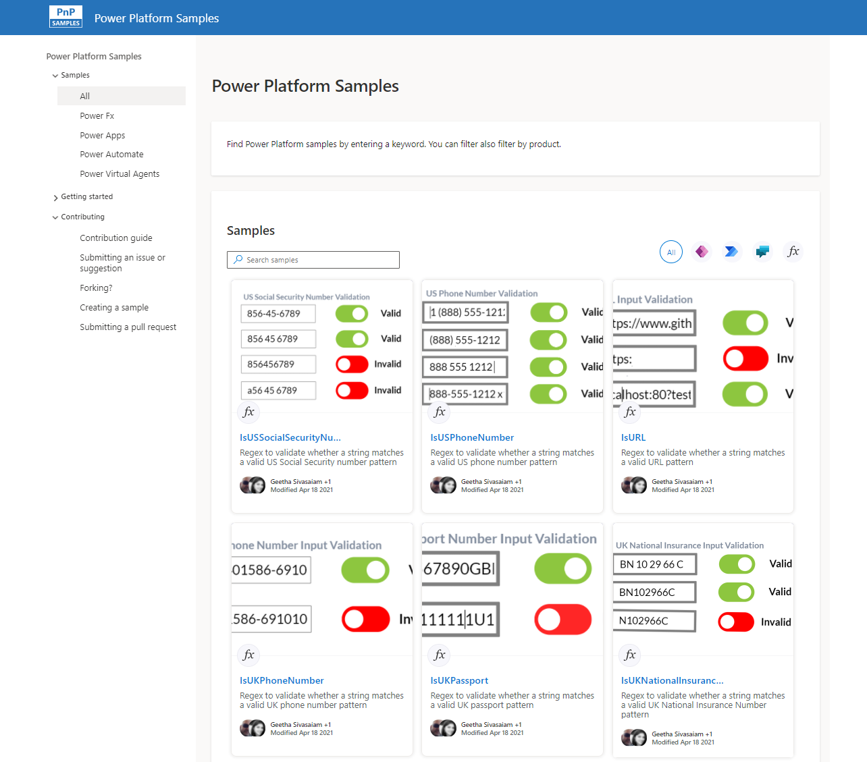
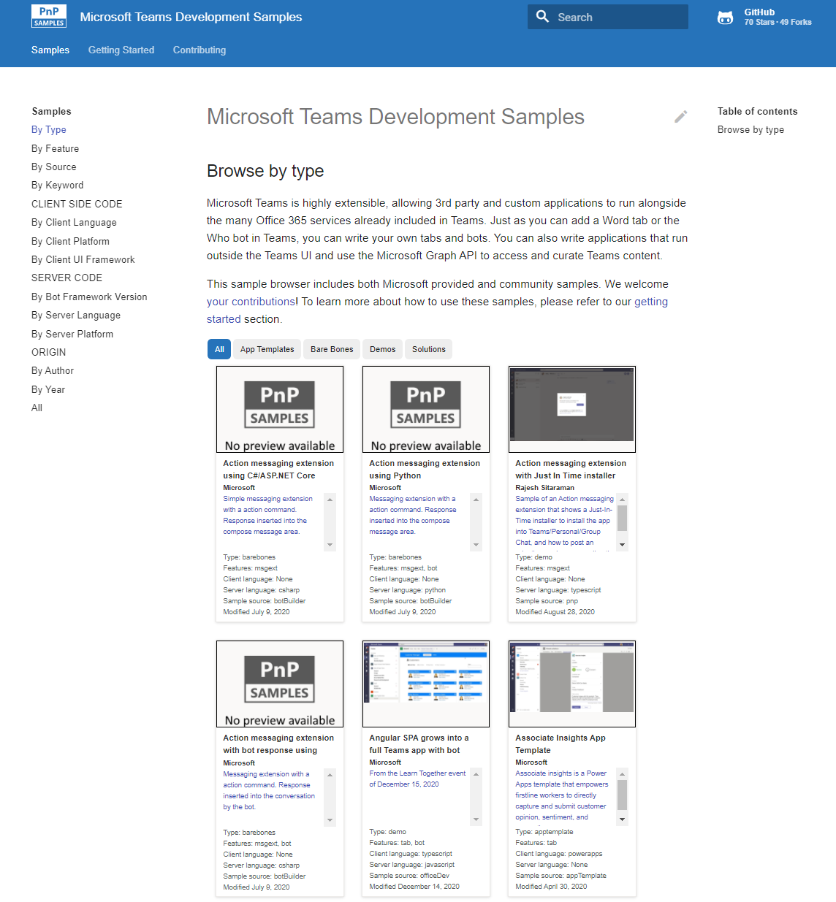
Microsoft 365 developer videos
Microsoft 365 community videos
Open-source
Sample galleries
Open-source initiatives and samples
aka.ms/m365devyoutube
aka.ms/m365/videos
github.com/pnp
github.com/officedev
github.com/microsoftgraph
github.com/sharepoint
aka.ms/m365/samples
aka.ms/teams-samples
aka.ms/spfx-webparts
aka.ms/spfx-aces
aka.ms/powerplatform-samples
aka.ms/spfx-extensions
aka.ms/list-formatting
aka.ms/m365/community
@Microsoft365Dev | @m365pnp
One URL to rule them all…

Slide 5
Microsoft 365 developer community calls
Microsoft 365 platform (weekly) https://aka.ms/m365-dev-call
(Notice. This call is on a summer break between July 1st and 31st of August 2022 – back on 6th of September)
Adaptive Cards https://aka.ms/adaptivecardscommunitycall
Microsoft identity platform https://aka.ms/IDDevCommunityCalendar
Office Add-ins https://aka.ms/officeaddinscommunitycall
Power Platform https://aka.ms/PowerPlatformCommunityCall
Microsoft 365 and Power Platform community (bi-weekly) https://aka.ms/m365-dev-sig
Viva Connections & SharePoint Framework (bi-weekly) https://aka.ms/spfx-call
Download recurrent invites from
https://aka.ms/m365/calls
Notes:
m365-dev-sig

Slide 6
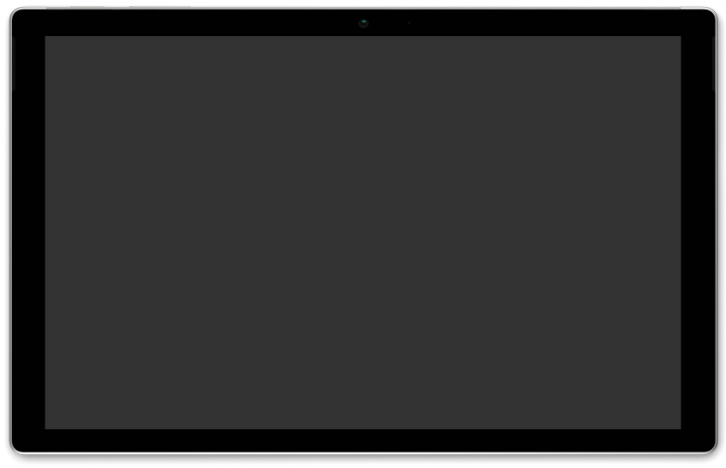
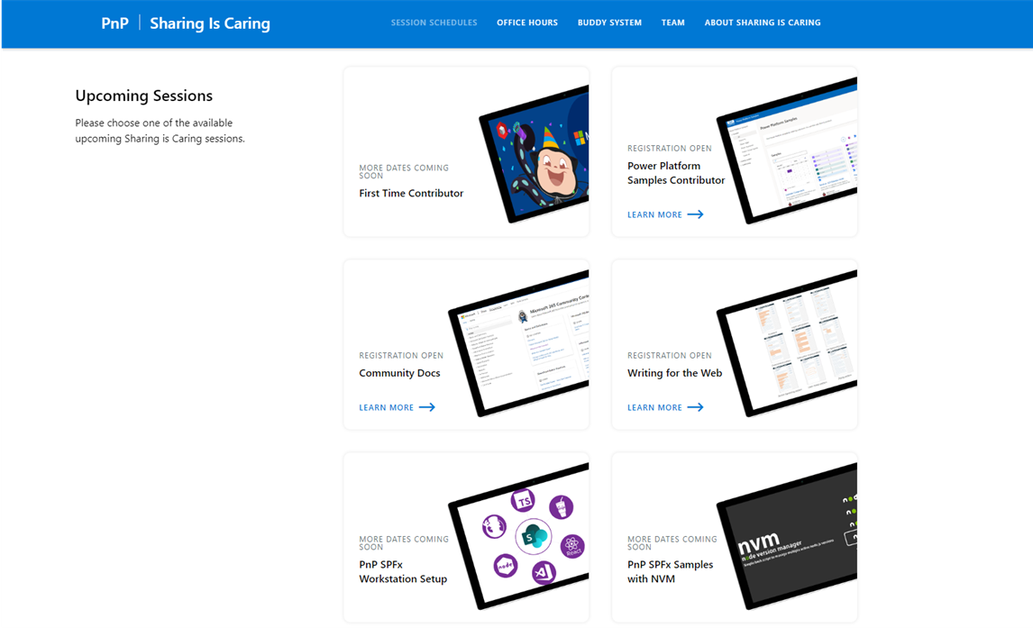
GUIDANCE
Learn how to get started in the open-source PnP community!
Upcoming Sessions:
First-time contributor
Community docs
Using PnP SPFx samples w/ NVM
SPFx developer workstation setup
More than code with VS Code
First-time presenter
M365 Maturity Model Practitioners
Power Platform Samples Contributor
Writing for the Web
September & October Dates
https://aka.ms/sharing-is-caring
Notes:
25 Total attendees, 16 attendees who attended both First-Time Contributors and Community Docs sessions.

Slide 7





COMMUNITY
Recognition Program
Showcase your contributions
Powered by Credly
More achievement levels coming soon
https://aka.ms/m365pnp-recognition
Notes:
25 Total attendees, 16 attendees who attended both First-Time Contributors and Community Docs sessions.

Slide 8
SharePoint Framework Latest from Microsoft engineering for Microsoft Viva, Microsoft Teams and SharePoint extensibility

Slide 9
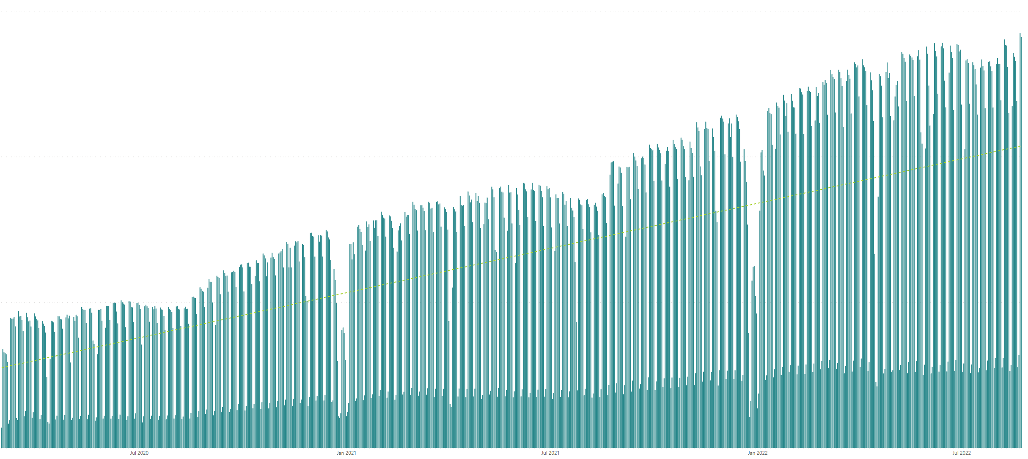

Rolling 28 days active users (MAU) for custom SharePoint Framework components in M365 There are currently tens of millions of monthly active users for customer and partner created SharePoint Framework components in Microsoft 365
All time highest usage in a day – Monday 22nd of August 2022
Jan 2020
Jul 2020
Jan 2021
Jul 2021
Jan 2022
Jul 2022

Slide 10




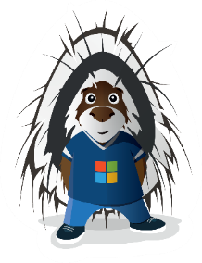
The Road Ahead – SPFx roadmap
1.15.2 – Released 2 weeks ago
Enable Service Principal Registration in app acquisition flow
New media action type for Viva Connections
ESLint support update based on community feedback
Bug fixes and adjustments based on GitHub issues
1.16 preview in upcoming week(s)
Teams JavaScript SDK v2 native support in SPFx solutions – rolling out also to existing solution
Asynchronous support for Viva Connections ACEs rendering
New Top Actions support for web parts - Top Actions allow developers to add custom actions to web part's command bar. The feature is like property pane controls but based on cleaner UI approach.
… and more… 🚀
1.16 General Availability in by end of 2022
1.17 ETA in December/January
and more across Microsoft Viva, Microsoft Teams and SharePoint

Slide 11

PnPjs Client-Side Libraries

Slide 12
























PnPjs Client-Side Libraries
Version 3.6 released Aug 16th
General documentation updates
Added getting started video series
Graph support for lists, content-types, columns
Update to simplify URL & query escaping
Bug fix for SharePoint sharing
Graph support for Special folders
Added edit method to SP content types
Updated properties for IViewInfo
Don’t forget about the nightly builds
npm install @pnp/sp@v3nightly --save
Docs: https://pnp.github.io/pnpjs/ @m365pnpjs on twitter

Slide 13
CLI for Microsoft 365

Slide 14
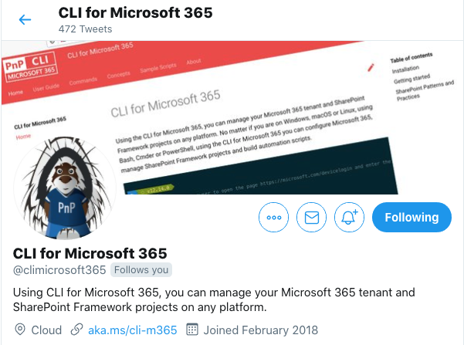
CLI for Microsoft 365
New 5.7 beta with:
Support for retrieving Microsoft Bookings
Support for granting admin consent for AAD apps
Support for managing SharePoint list role assignments
Support for setting SharePoint role inheritance on Webs
Support for removing Microsoft Search external connection
Support for verifying environment config for SPFx v1.15.2
And more...
Install and run 5.7 beta:
npm install -g @pnp/cli-microsoft365@next
docker run --rm –it m365pnp/cli-microsoft365:next
Release notes:
https://pnp.github.io/cli-microsoft365/about/release-notes/
@climicrosoft365 #CLIMicrosoft365 on Twitter
📖 aka.ms/cli-m365
🗣 github.com/pnp/cli-microsoft365/discussions
Notes:
Introduce yourself - "Hey everyone 👋 Its Garry here from the CLI team"
High level - "We have been busy adding new capabilities to CLI for Microsoft 365 v5.7 beta which we will release at the end of the month"
Summary - "In this release we have new commands and enhancements across Azure Active Directory, Microsoft Bookings, SharePoint Online and SPFx, as well as general improvements and bug fixes. Most notably we have added a new commands for Microsoft Bookings, our first for this service. We also welcome two new maintainers to the team this month, Jasey Waegebaert and Milan Holemans."
CTA (engage) - "I have provided some links in the chat for you to access all the key resources surrounding this release"
CTA (check docs) - "please checkout the release notes for further detail on what has been included so far"
CTA (install) - "If you want to try out the beta version, you can install directly from npm, or alternatively use our Docker image to run CLI in a container"
CTA (follow us) - "If you want to keep up with the latest beta releases, I recommend that you can follow our Twitter account @climicrosoft365"
CTA (feedback) - "If you have any feedback (both positive and negative) or ideas for new features that you'd like to see, then please checkout the GitHub repo, and either raise an issue or start a discussion, we would absolutely love to hear from you"
Closing (Thank you) - "Finally, thank you to all the contributors who made this release possible. That’s all for now, thank you”
📝 Release notes - CLI for Microsoft 365 (pnp.github.io)
👷 Jasey Waegebaert and Milan Holemans join CLI for Microsoft 365 maintainers team (pnp.github.io)
📆 business list - CLI for Microsoft 365 (pnp.github.io)
📦 @pnp/cli-microsoft365 - npm (npmjs.com)
🐳 Run CLI in a Docker Container - CLI for Microsoft 365 (pnp.github.io)
💬 CLI for Microsoft 365 (@climicrosoft365) / Twitter
💻 pnp/cli-microsoft365: Manage Microsoft 365 and SharePoint Framework projects on any platform (github.com
We have open discussions on commands to manage comments on pages/list item, file versions and document sets.

Slide 15
SPFx Reusable Components

Slide 16
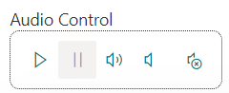
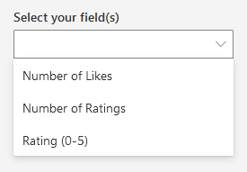
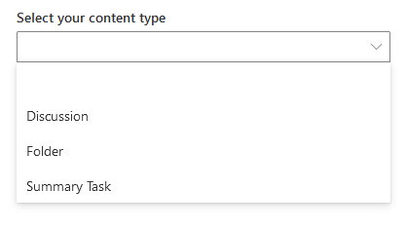
Reusable SPFx Controls
React Controls – 3.10.0
SPFx 1.15.2 support
ability to override field rendering for individual fields in Dynamic Form
Various fixes
Release notes: https://pnp.github.io/sp-dev-fx-controls-react/about/release-notes/
React Property Controls – 3.9.0
SPFx 1.15.2 support
Release notes: https://pnp.github.io/sp-dev-fx-property-controls/about/release-notes/
Special thanks to our contributors: Bart-Jan Dekker, Edin Kapic, Milan Holemans, Steve Beaugé.
More information:
https://sharepoint.github.io/sp-dev-fx-property-controls https://sharepoint.github.io/sp-dev-fx-controls-react
Twitter: @M365PnPControls

Slide 17
PnP Modern Search

Slide 18
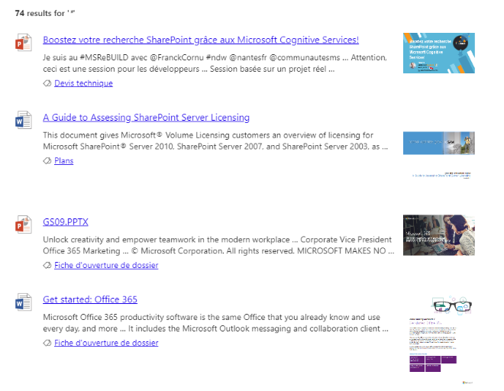

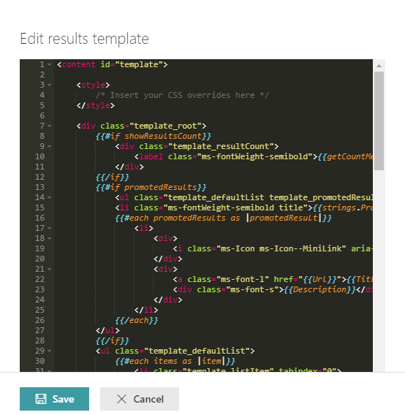
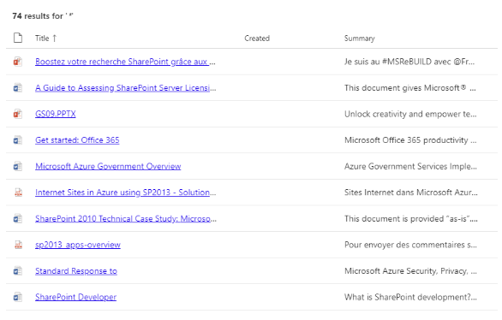

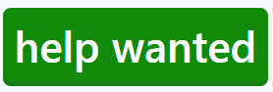
PnP Modern Search
http://aka.ms/pnp-search
Building modern Search experiences with flexible web parts
v4.7.0 – June 2022 release
https://github.com/microsoft-search/pnp-modern-search/releases/tag/4.7.0-beta
Thank you @d-martins, @bruzie, @rick-brown-slalom, @mrjarbenne, @davemehr for your support
Support for Adaptive Card rendering
See release notes for fixes and new features
v3.23.0 – December 2021 release
https://github.com/microsoft-search/pnp-modern-search/releases
See release notes for fixes and new features
Notes:
https://github.com/microsoft-search/pnp-modern-search

Slide 19

PnP SPFx Samples

Slide 20
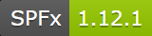
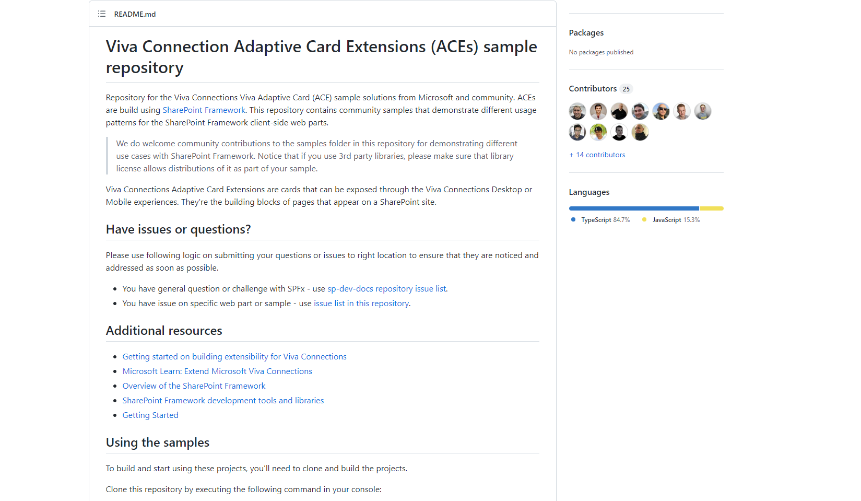
PnP SPFx ACEs
PnP SPFx Samples
PnP SPFx Samples
https://aka.ms/spfx-aces
Shared Graph client (with batching) Marcin Wojciechowski | @mgwojciech
*** We Love New Samples ***
Follow Documents André Lage | @aaclage
See all samples from https://aka.ms/m365/samples
Notes:
This is a sample how we can reuse graph client between ACEs from a different solutions. This can be quite handy especially if we implement batching strategy (as in this sample). Thanks to that requests from all ACEs can be batched together, which improves performance and overall end user experience

Slide 21


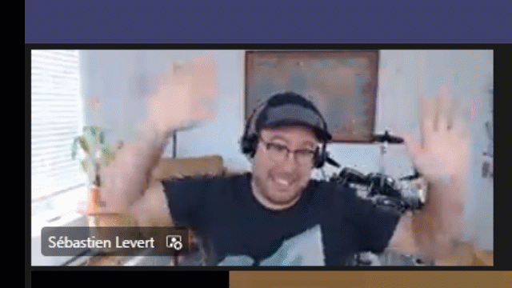
Optional picture time!
Video on and we’ll grab a Together Mode pic with those who are willing to do this.
We are together on this as a community!
Let’s all be like Seb?
By enabling your camera for the picture, you grant us permission to share your picture in social media.

Slide 22

DEMO
Using the Microsoft Graph education endpoints in SPFx to create a my assignments web part – Tony Philips (Cloud Design Box)
Getting started on building custom list form experiences with SharePoint Framework – Waldek Mastykarz (Microsoft)

Slide 23
Thank you
Recording will be available in 24 hours on
Microsoft 365 Community (PnP) YouTube channel
https://aka.ms/m365/videos
(subscribe today)
Follow us on Twitter
@Microsoft365Dev | @M365PnP
Next Viva Connections & SPFx call: September 8th at 07:00am PT
Next M365 General Dev call: September 1st at 07:00am PT
All available community calls from https://aka.ms/m365/calls

Slide 24


aka.ms/m365pnp

